Slide 1
CURSO DE REST

Slide 2
WHAT IS A REST API? ALLOWS SYSTEMS TO INTERACT

Slide 3


Slide 4
WHAT IS A REST API? FUNCTIONS BELOW INTERFACES

Slide 5
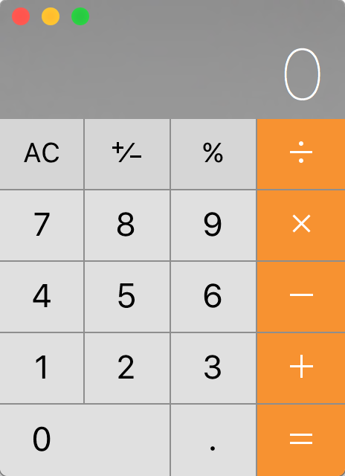

Slide 6
WHAT IS A REST API? REQUESTS AND RESPONSES

Slide 7
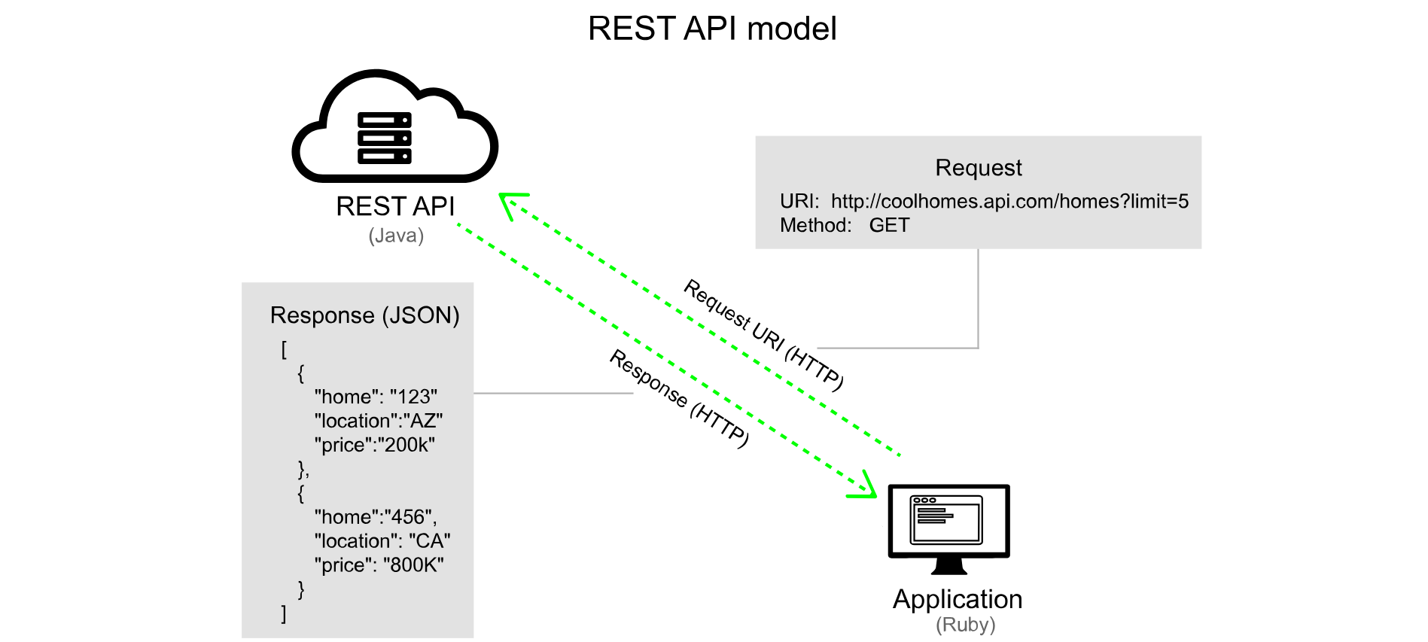

Slide 8
WHAT IS A REST API? THE WEB FOLLOWS REST

Slide 9
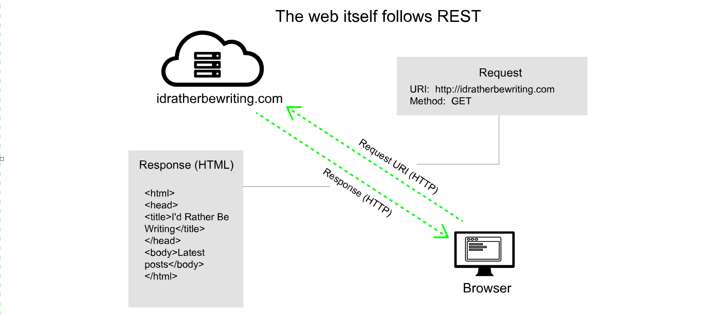

Slide 10
SUBMIT REQUESTS POSTMAN

Slide 11
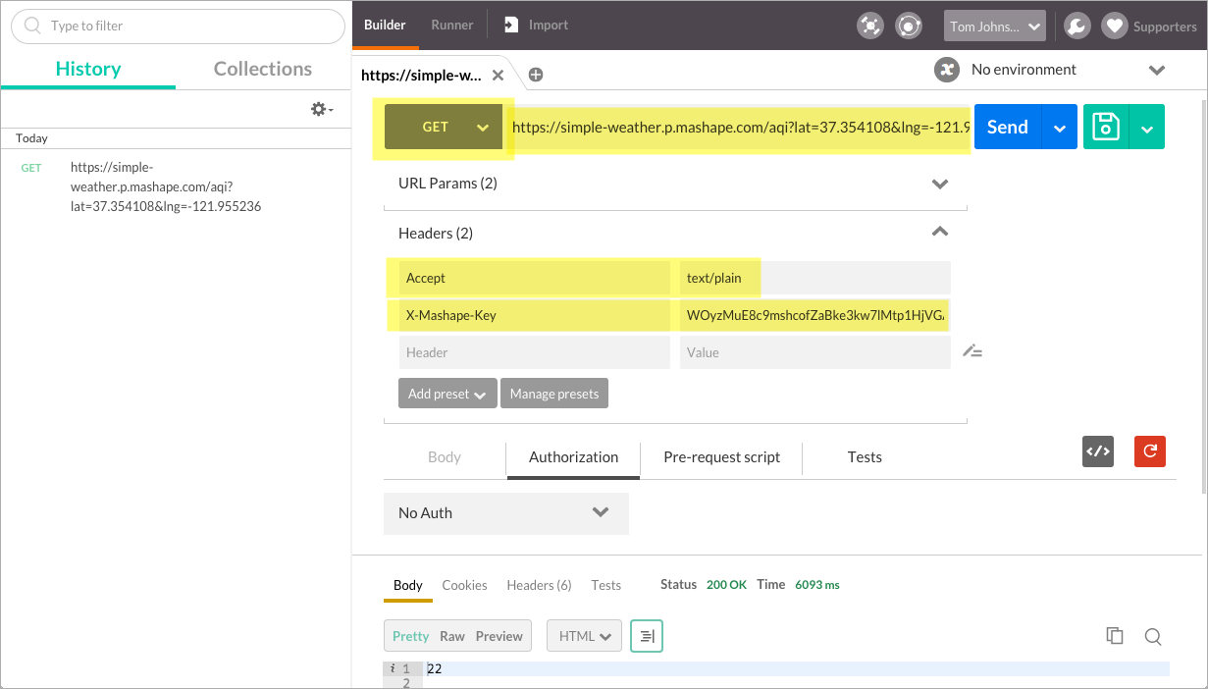

Slide 12
DOCUMENTING ENDPOINTS
Resource description
Resource URL
Methods
Parameters
Request example
Response example
Status and error codes
Code samples

Slide 13
1. RESOURCE DESCRIPTIONS
DESCRIPTION
The information contained in the resource — brief (1-3 sentences) and usually starts with a verb.

Slide 14
2. RESOURCE URL
DESCRIPTION
The URL path where the resource can be accessed. Doesn't include the base path.

Slide 15
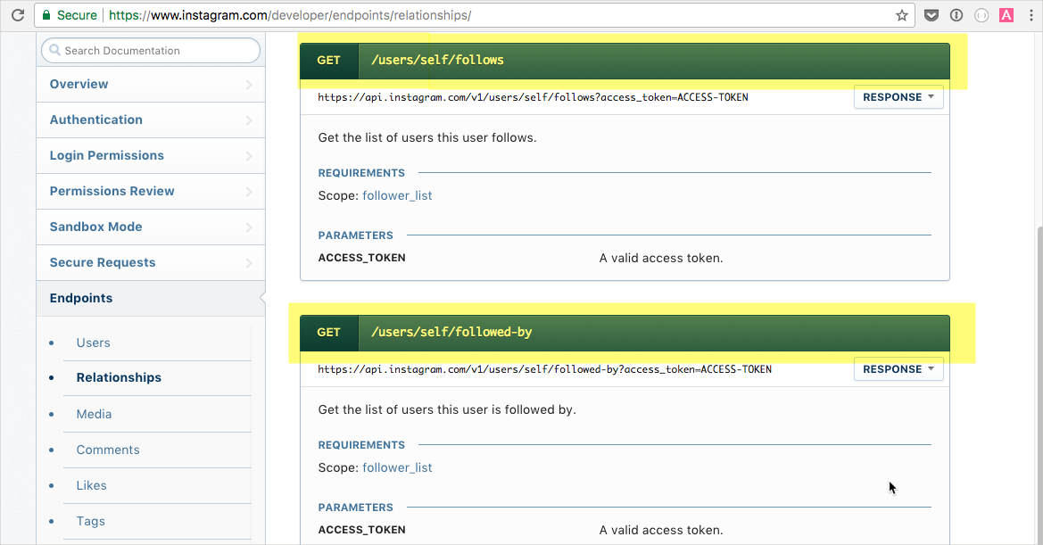

Slide 16
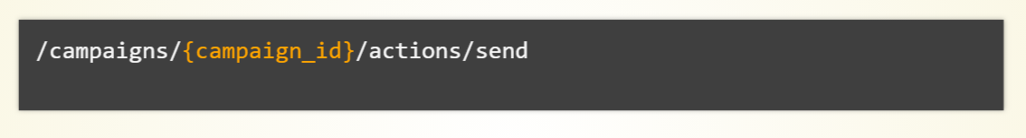
PUT PATH PARAMETERS IN CURLY BRACES

Slide 17
3. METHOD
DESCRIPTION
The operations allowed for the resource URL (GET, POST, PUT, DELETE, etc.)

Slide 18
4. PARAMETERS
DESCRIPTION
Options you can use with the endpoint. There are four types of parameters: header, path, query string, and request body.

Slide 19
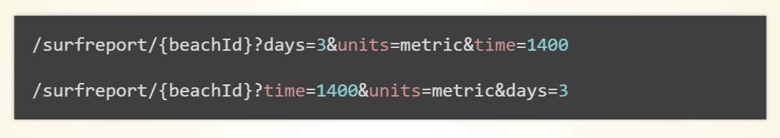
PARAMETER ORDER IS IRRELEVANT

Slide 20
NOTE THE DATA TYPES IF IMPORTANT
string
integer
boolean
object

Slide 21
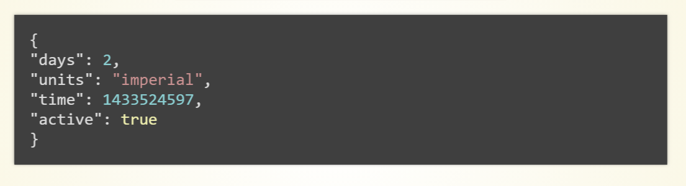
REQUEST BODY PARAMETER EXAMPLE

Slide 22
5. REQUEST EXAMPLE
DESCRIPTION
A sample request to the resource, showing the endpoint and parameters configured.

Slide 23
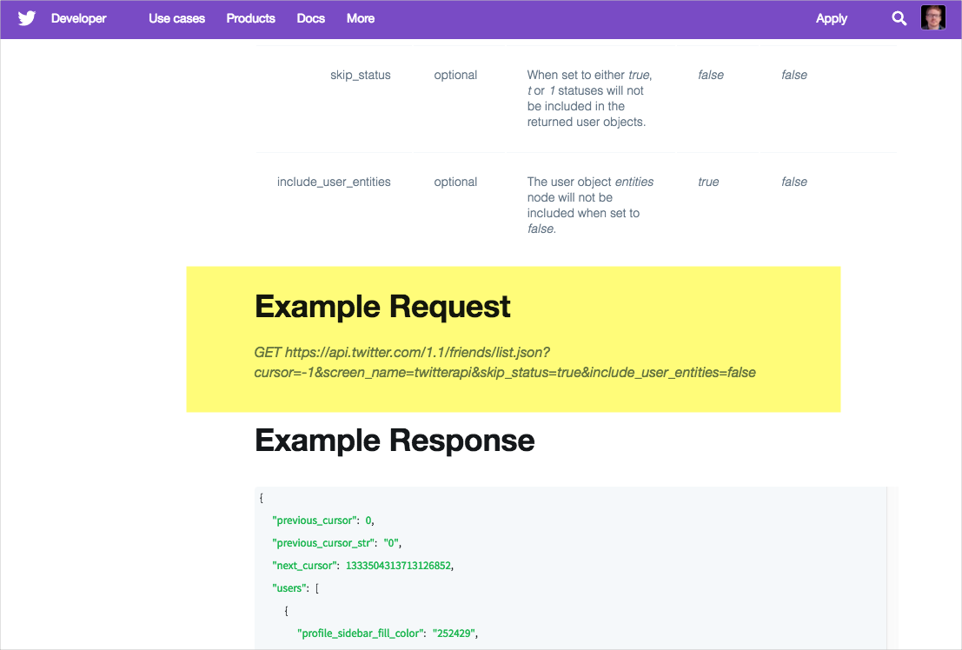
REQUEST BODY PARAMETER EXAMPLE

Slide 24
6. RESPONSE EXAMPLE
DESCRIPTION
A sample request to the resource, showing the endpoint and parameters configured.

Slide 25
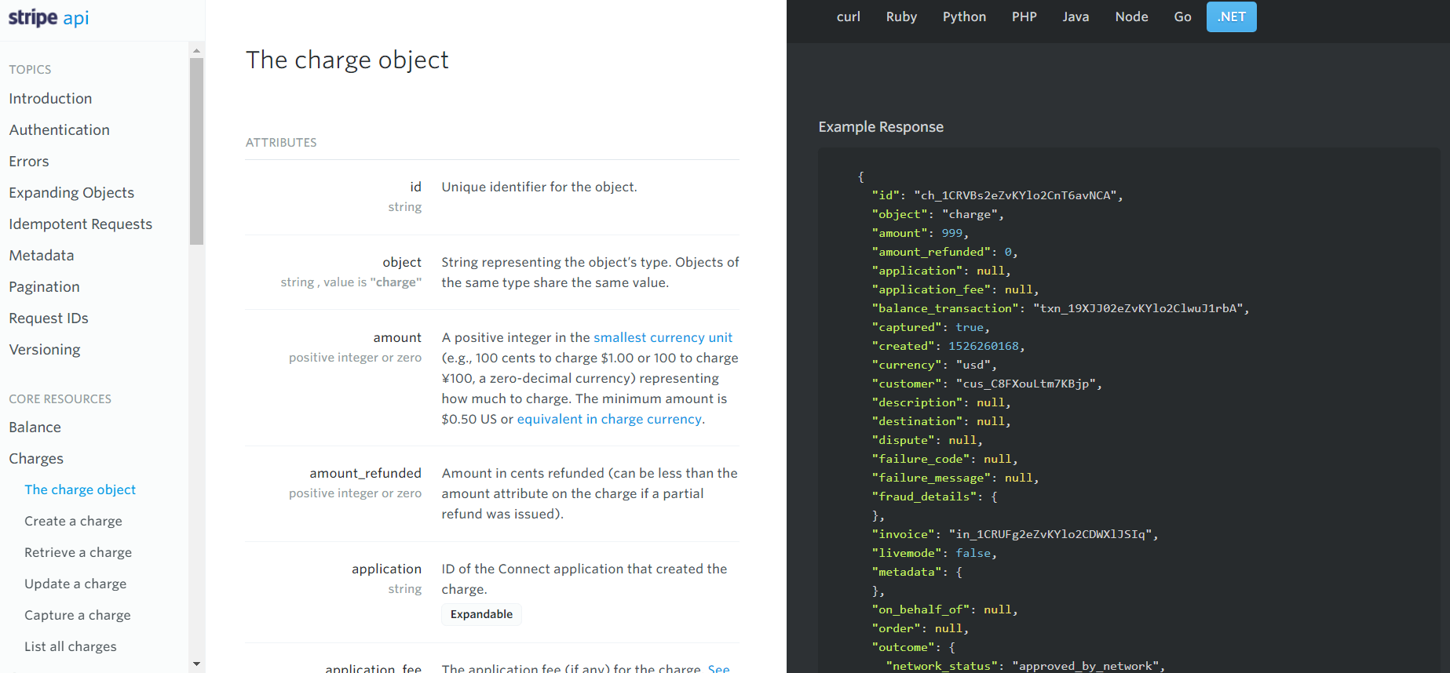

Slide 26
7. STATUS AND ERROR CODES
DESCRIPTION
Code in the response that indicates a general status of the response. Most status codes (e.g., 200, 302, 500, etc.) are standard.

Slide 27
REQUEST BODY PARAMETER EXAMPLE

Slide 29
Versionamento de API’s

Slide 30
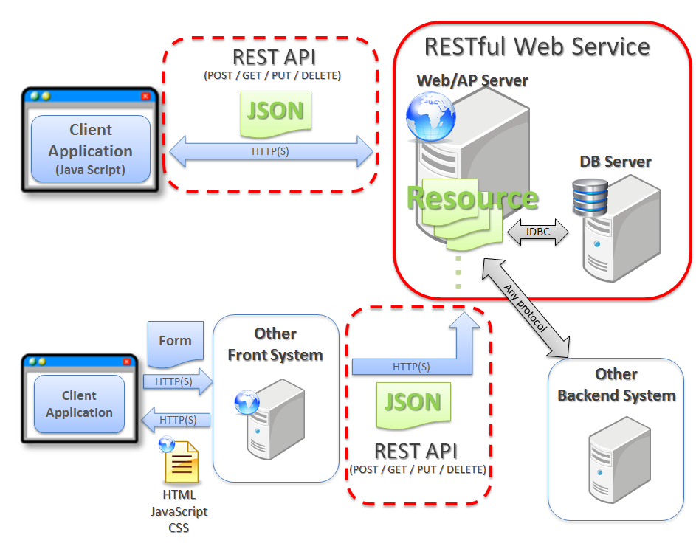

Slide 31
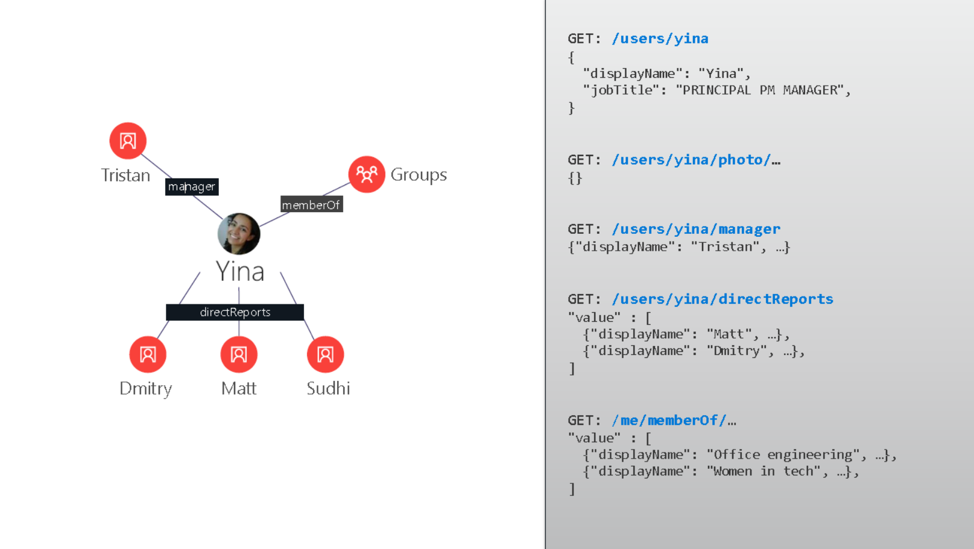

Slide 32
Verbos: GET

Slide 34
Verbos: POST

Slide 36
Verbos: PUT

Slide 38
Verbos: DELETE

Slide 40
RATE LIMITING AND THRESHOLDS

Slide 41
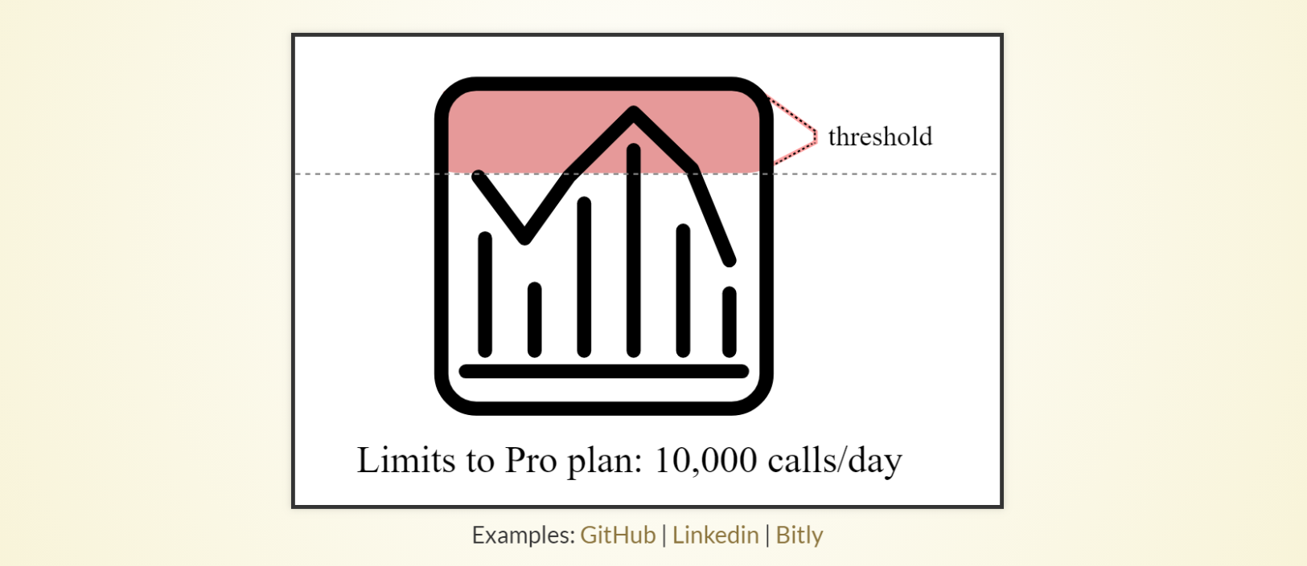

Slide 42
SDKS AND SAMPLE APPS

Slide 43
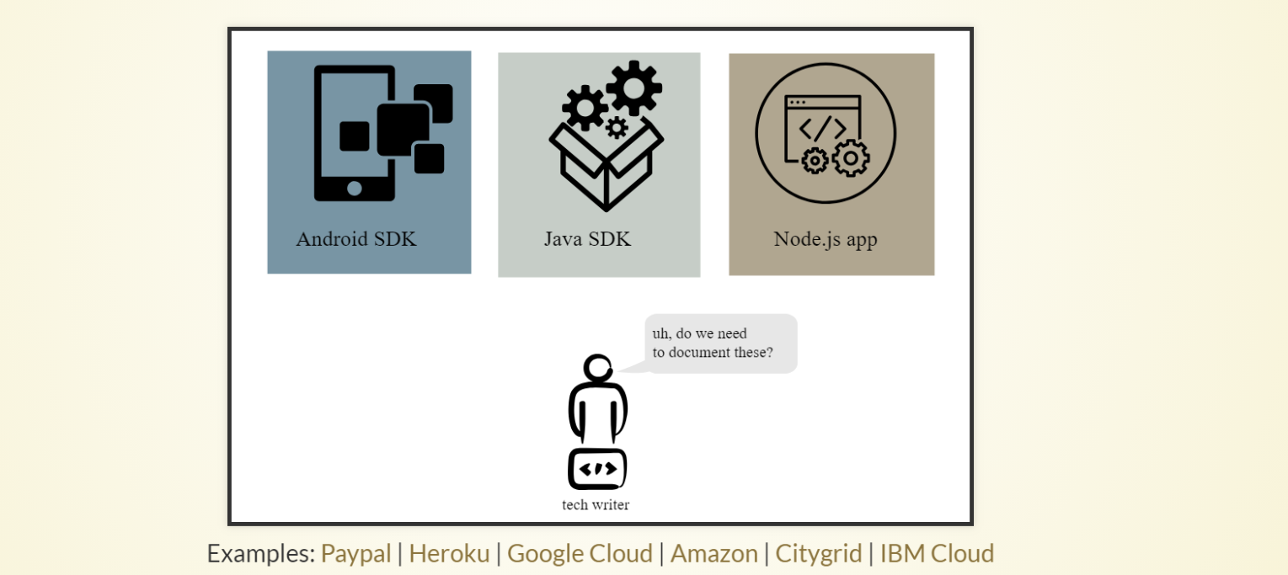

Slide 44
QUICK REFERENCE

Slide 45
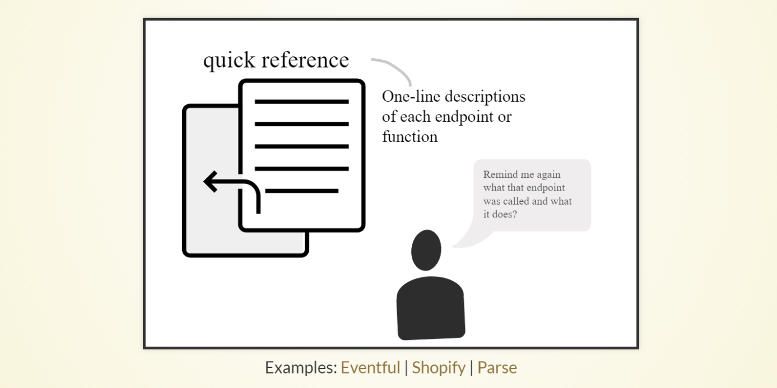

Slide 46
BEST PRACTICES

Slide 47
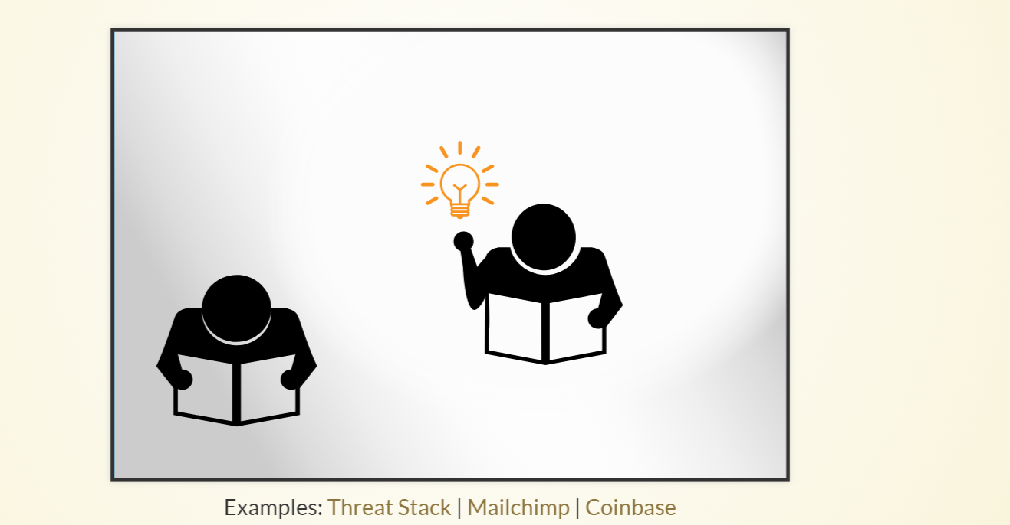

Slide 48
Sample best practice topics
pagination, time ranges, fault tolerance, cache values, connectivity, timeouts, downtime, SSL, versions, testing and validation, exports, languages, number handling, expanding resources, notifications, etc.

Slide 49
STATUS AND ERROR CODES

Slide 50
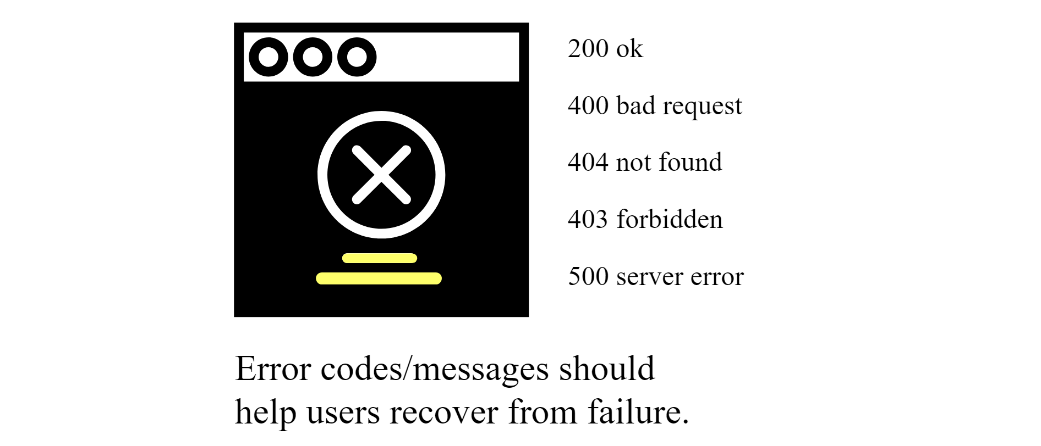

Slide 51
Documentando RESTFull API’s

Slide 52


Slide 53
Concepts more than technical details
The kind of documentation engineers want
Swagger UI and how to use it
OpenAPI specification and how to create them
Other interactive documentation platforms

Slide 54
AUTHORIZATION AND AUTHENTICATION

Slide 55
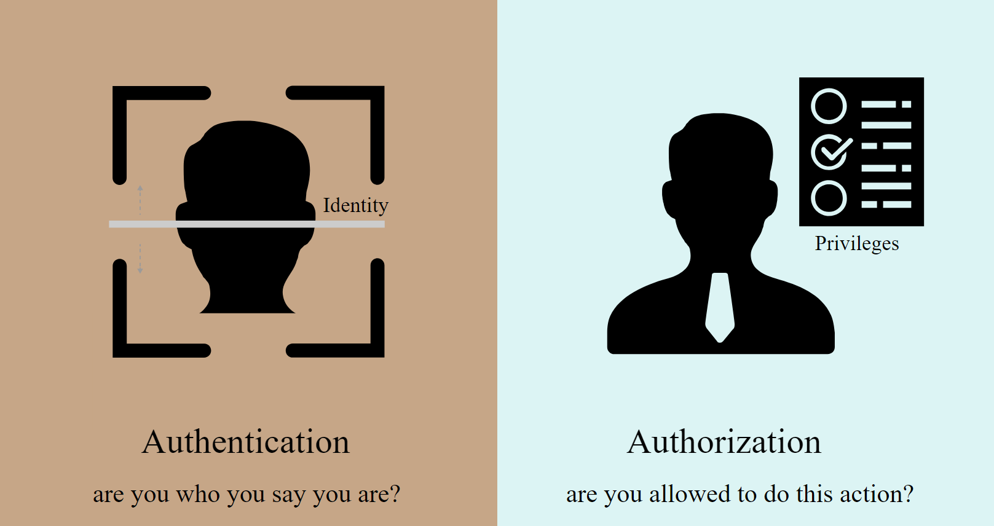

Slide 56
REFERÊNCIAS
http://idratherbewriting.com/learnapidoc/docapis_introtoapis.html
https://github.com/nbarbettini/BeautifulRestApi

